Slide 1


Evolving world of biometric authentication

Slide 2
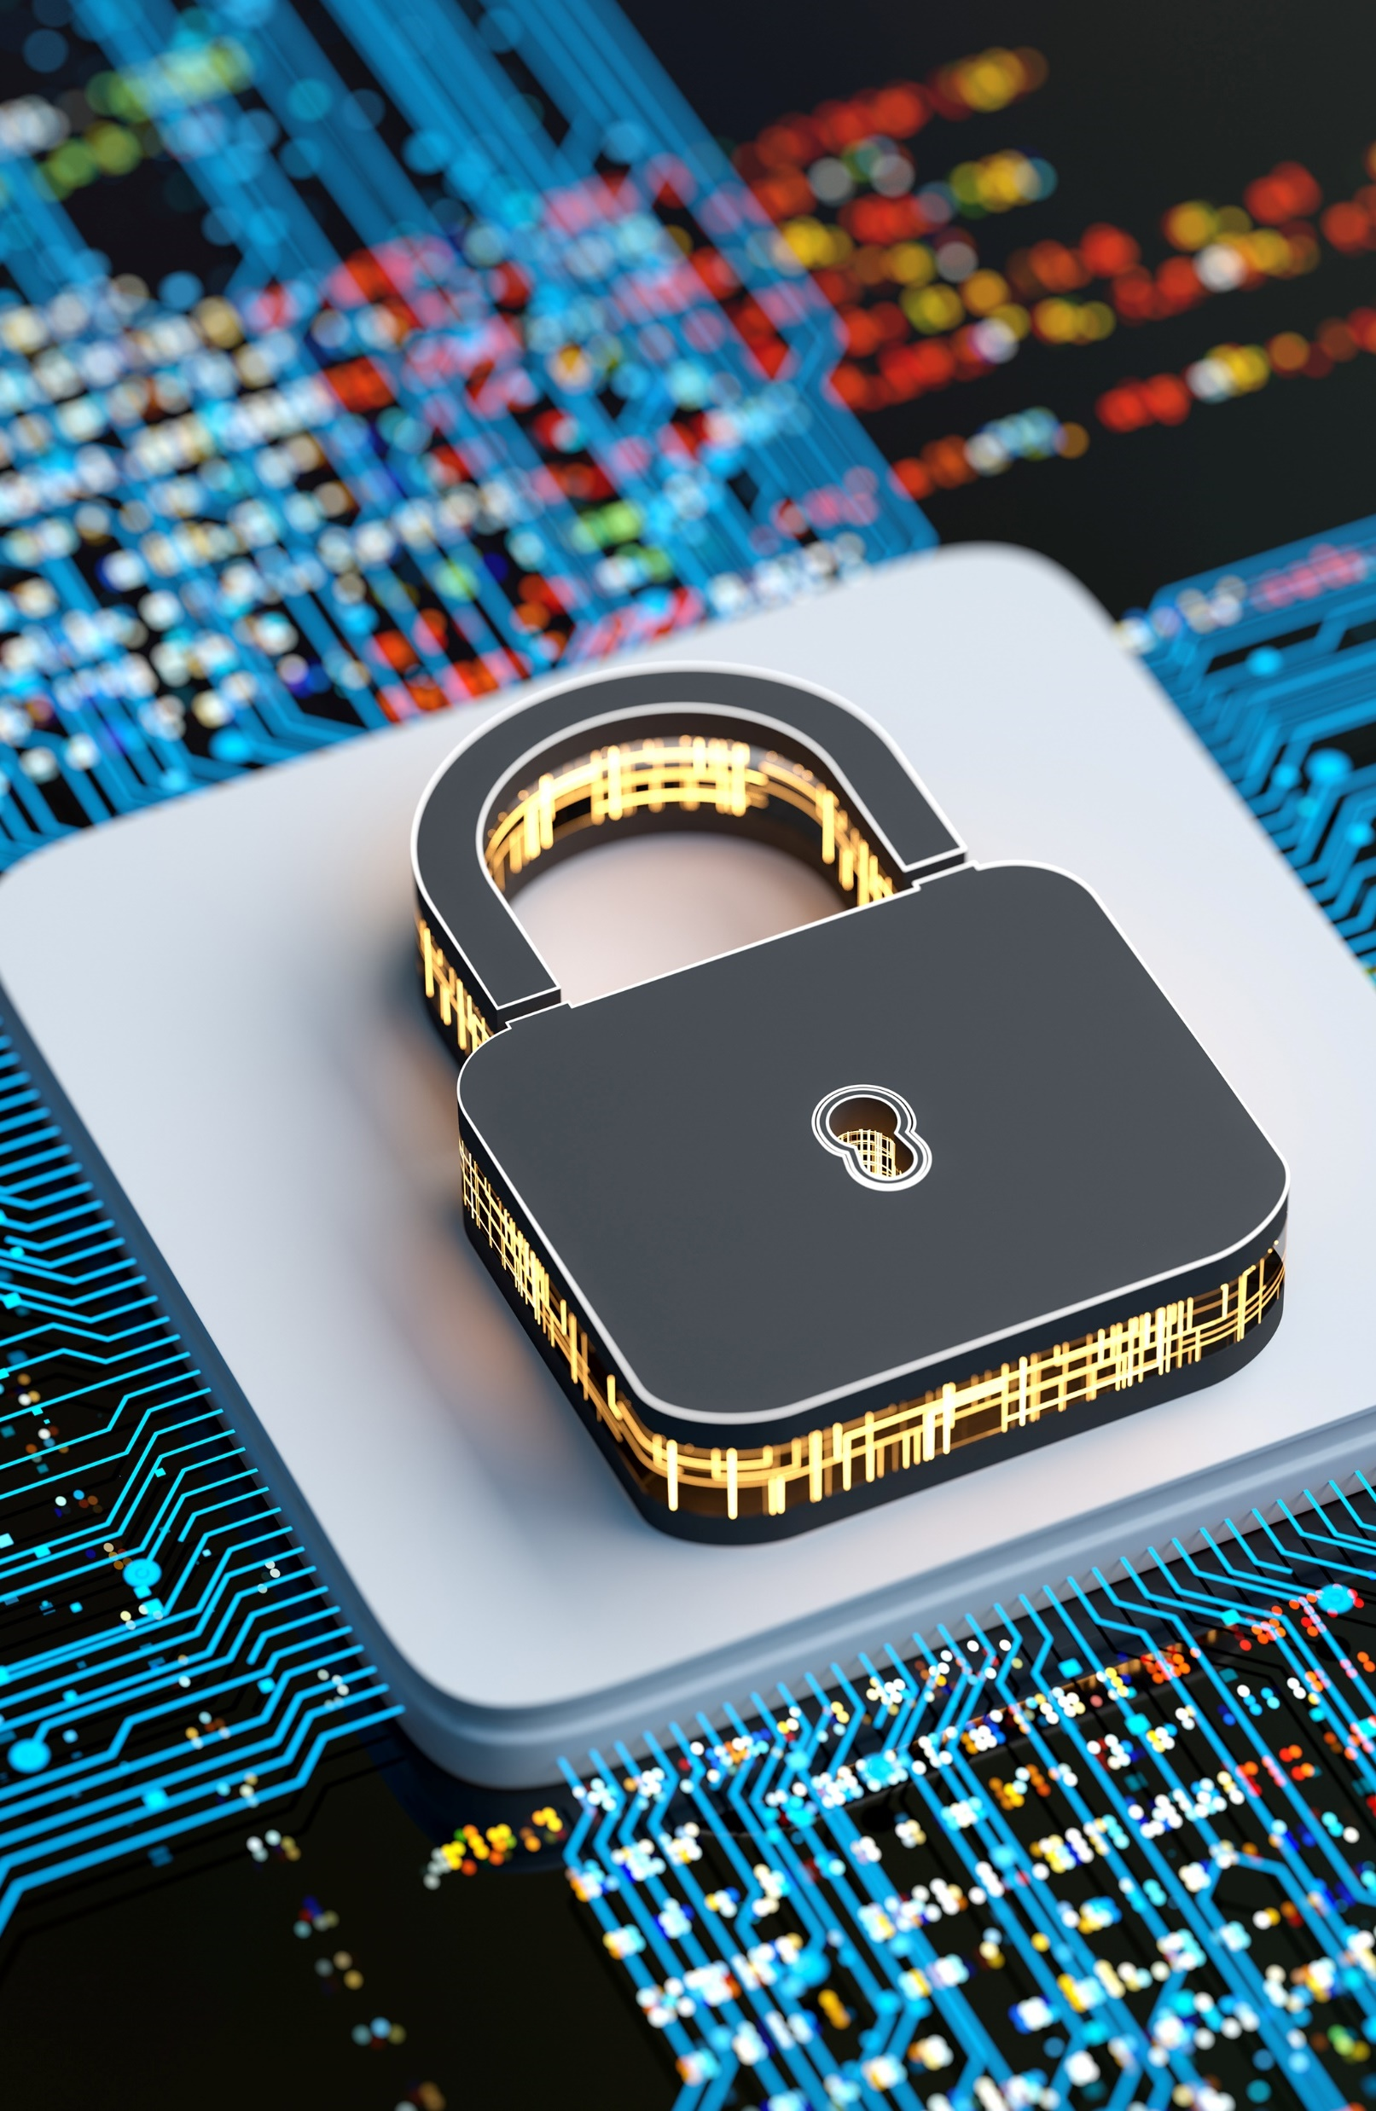
Session Outline
Authentication:
Passwords & tokens
Biometrics
Tools for this session:
Biometric peripherals
Biometric worksheet

Slide 3
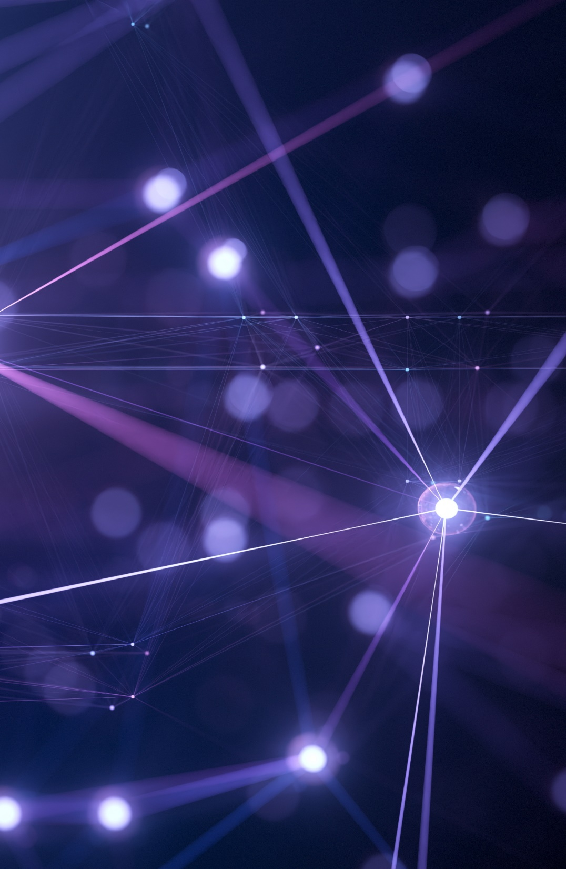
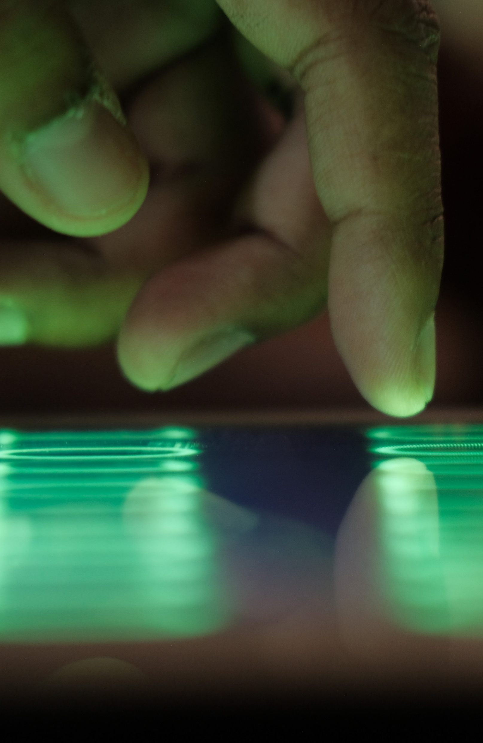
What is authentication?
Authentication is the process that companies use to confirm that only the right people, services, and apps with the right permissions can get organizational resources. It’s an important part of cybersecurity because a threat actor’s number one priority is to gain unauthorized access to systems. They do this by stealing the username and passwords of users that do have access.
The authentication process includes three primary steps:
Identification: Users establish who they are typically through a username.
Authentication: Typically, users prove they are who they say they are by entering a password (something only the user is supposed to know), but to strengthen security, many organizations also require that they prove their identity with something they have (a phone or token device) or something they are (fingerprint or face scan).
Authorization: The system verifies that the users have permission to the system that they’re attempting to access.
Source: https://www.microsoft.com/en-us/security/business/security-101/what-is-authentication

Slide 4
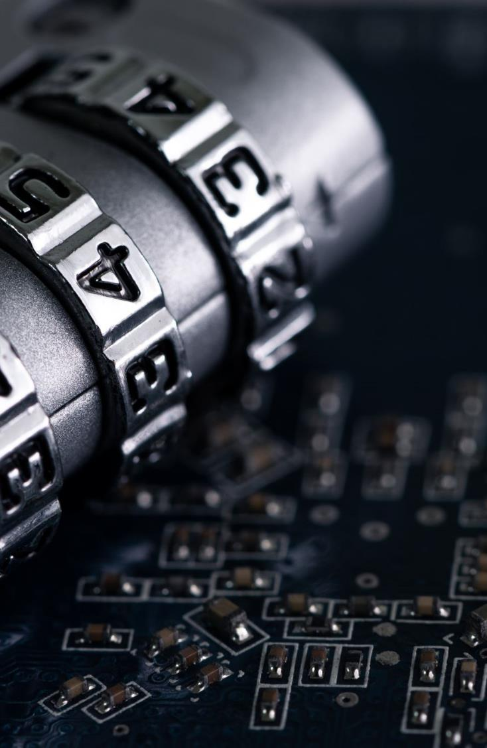
Three forms of authentication
Passwords:
A string of characters (letters, numbers, and other symbols) that are used to authenticate an identity or to verify access authorization.
Tokens:
A portable, user-controlled, physical device (e.g., smart card or memory stick) used to generate a code that verifies the users identity.
Biometrics:
Measurable physical characteristics or personal behavioural traits used to identify, or verify the claimed identity of, an individual. Facial images, fingerprints, and handwriting samples are all examples of biometrics.
Source: https://csrc.nist.gov/glossary

Slide 5
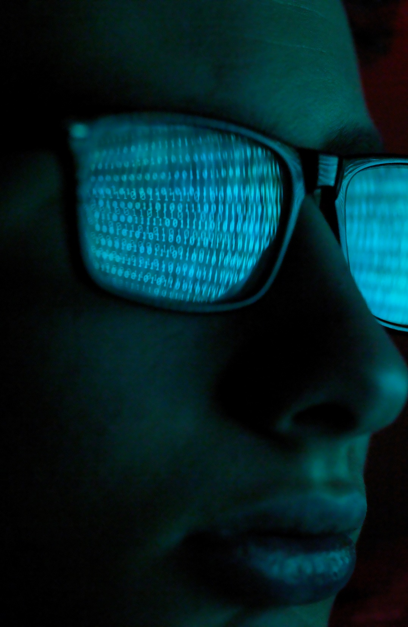
Password weaknesses
Passwords are often badly selected (and easily guessed):
They might be too short, are made up of personal data such as names, birthdates or dictionary words.
This makes them vulnerable to password cracking software.
User error:
Passwords written down and discoverable, infrequently changed and used for multiple accounts across multiple systems.

Slide 6

Token weaknesses
Expensive to implement:
Introducing token based authentication could be cost prohibitive for an organization and cost would scale depending on the number of employees being enrolled.
Easily lost or stolen:
A threat actor might be able to easily obtain a token if the user loses it or the threat actor has opportunity to steal it.

Slide 7
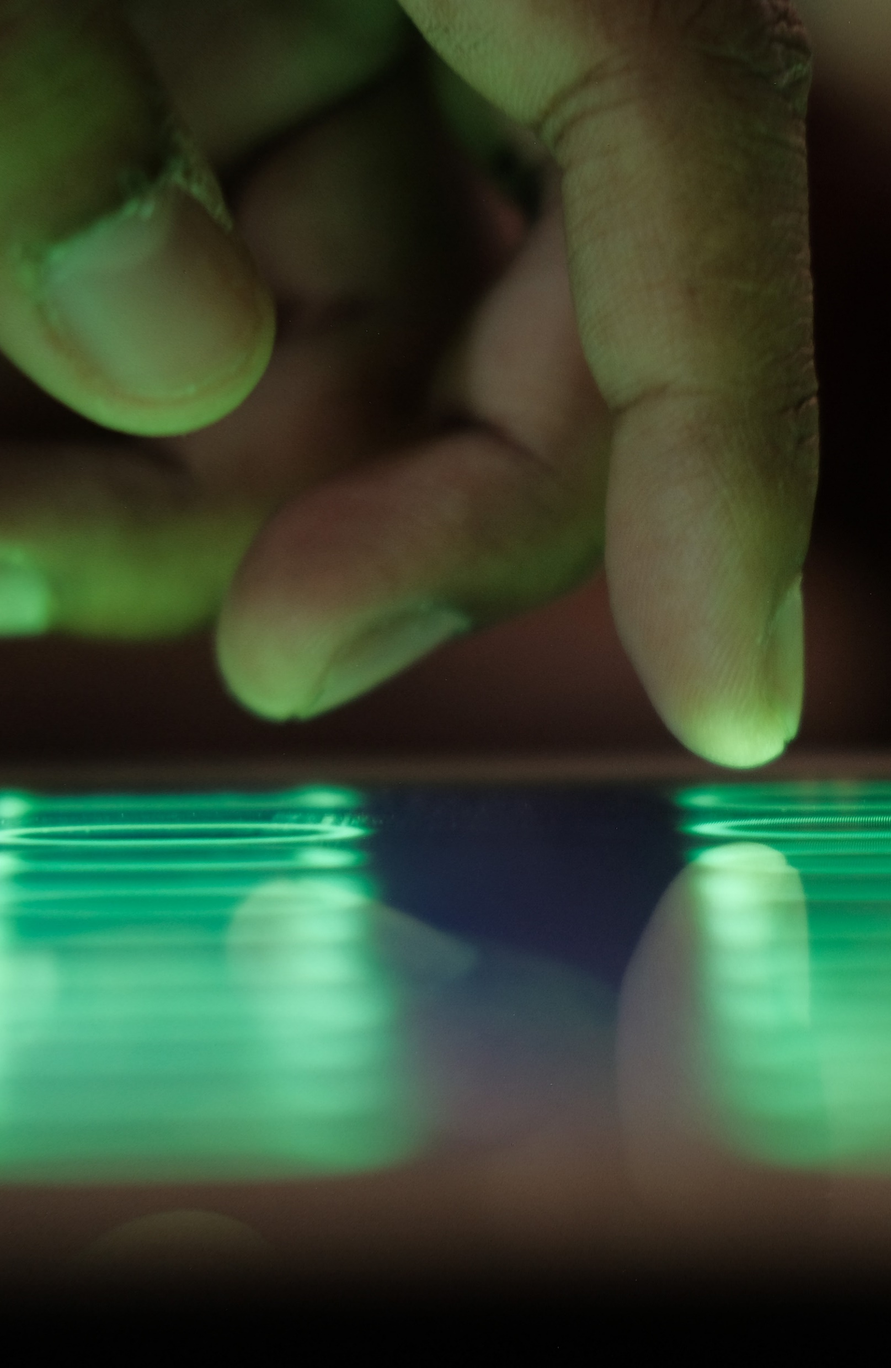
Potential of biometrics as authentication
Biometric authentication is based upon something the user is…
Theoretically biometrics are far more usable, there is nothing for the user to remember and nothing to them to lose or leave behind.
Practical factors (e.g., failure to acquire, false rejection) may limit tolerability.

Slide 8
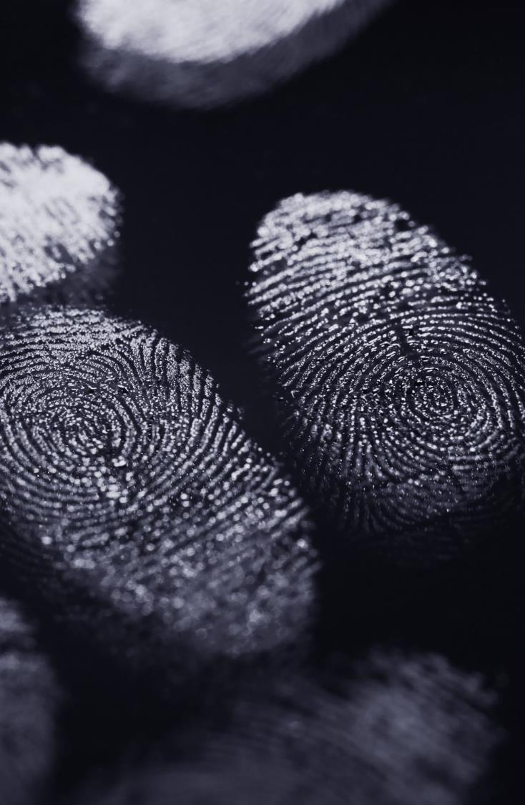
Desirable features of biometrics
Uniqueness - the ability to successfully discriminate people.
Universal - the ability for a technique to be applied to a whole population of users.
Permanence - the ability for the characteristics not to change with time.
Collectable - the ease with which a sensor is able to collect the sample.
Acceptable - the degree to which the technique is found to be acceptable by a person.
Circumventable - the ability not to duplicate or copy a sample.

Slide 9
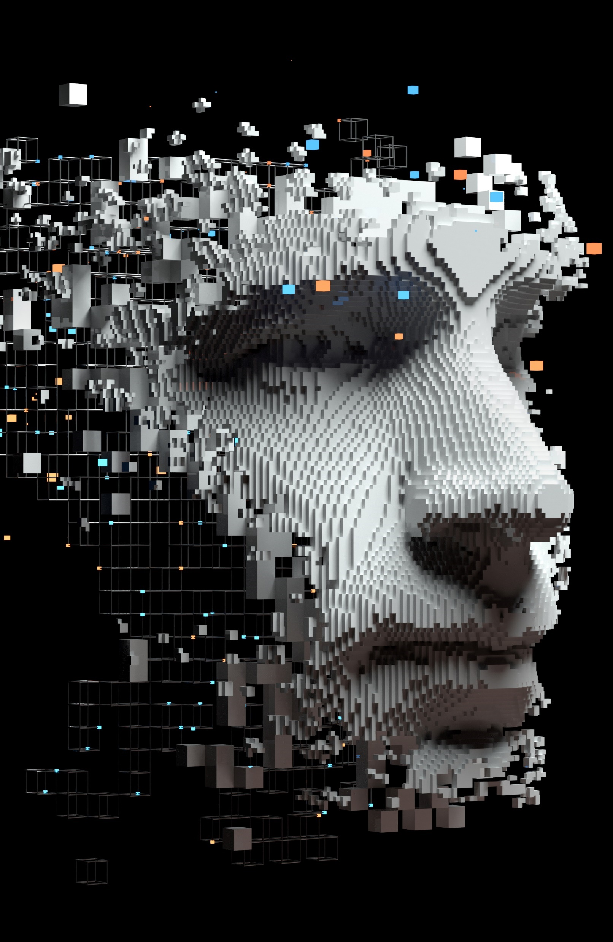
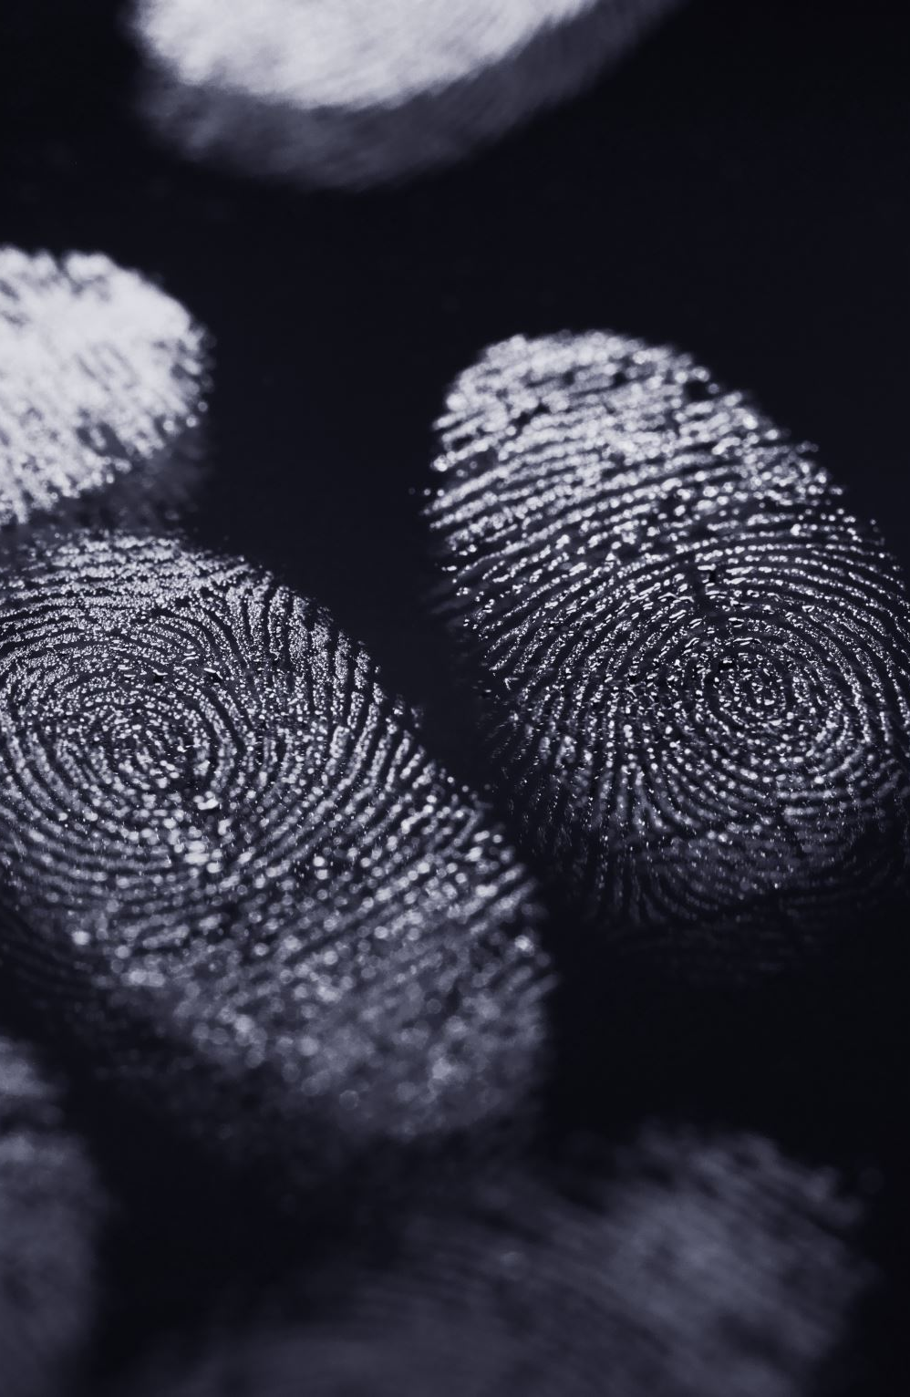
Biometric modalities
Physiological | Behavioural
Fingerprint Recognition Hand Geometry Vascular Pattern Recognition Iris Scanning Retinal Scanning Facial Recognition Facial Thermogram Ear print | Speaker Recognition Signature Recognition Keystroke Analysis Mouse Dynamics Gait Recognition Stylometry

Slide 10
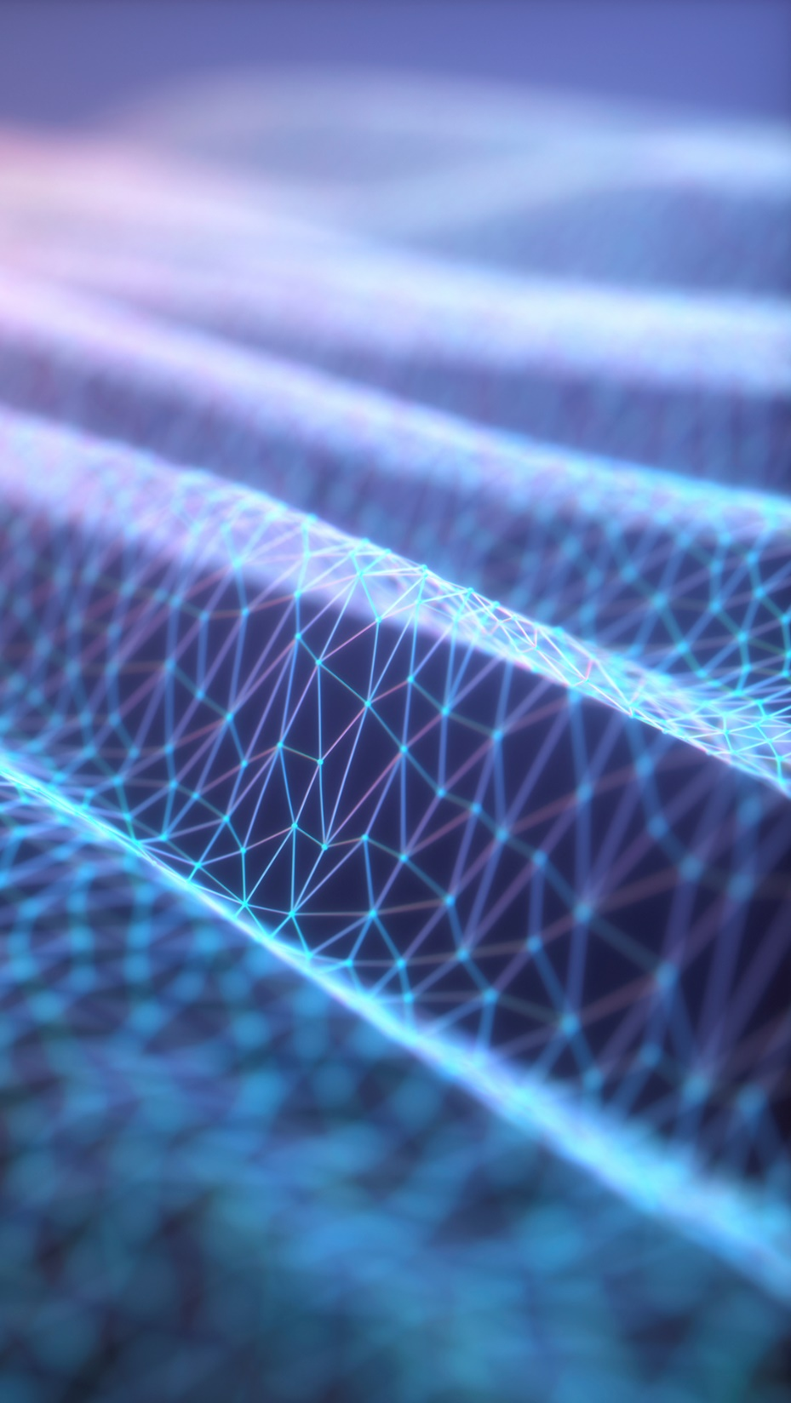
Activity: Enrolment on biometric systems
Using the biometric peripherals, have a go at enrolling on each of the systems.

Slide 11
Discuss: Usability and preferences
How usable do you think the three biometric options are?
Do you have a preference to one method in particular?
How do you think each of the modalities are used in practice?
Notes:
Discuss: Usability of the three approaches? Preferences towards one over another? Draw through the characteristics/attributes of usability, acceptance and collectability. Discuss how particular modalities are often linked to particular applications.

Slide 12
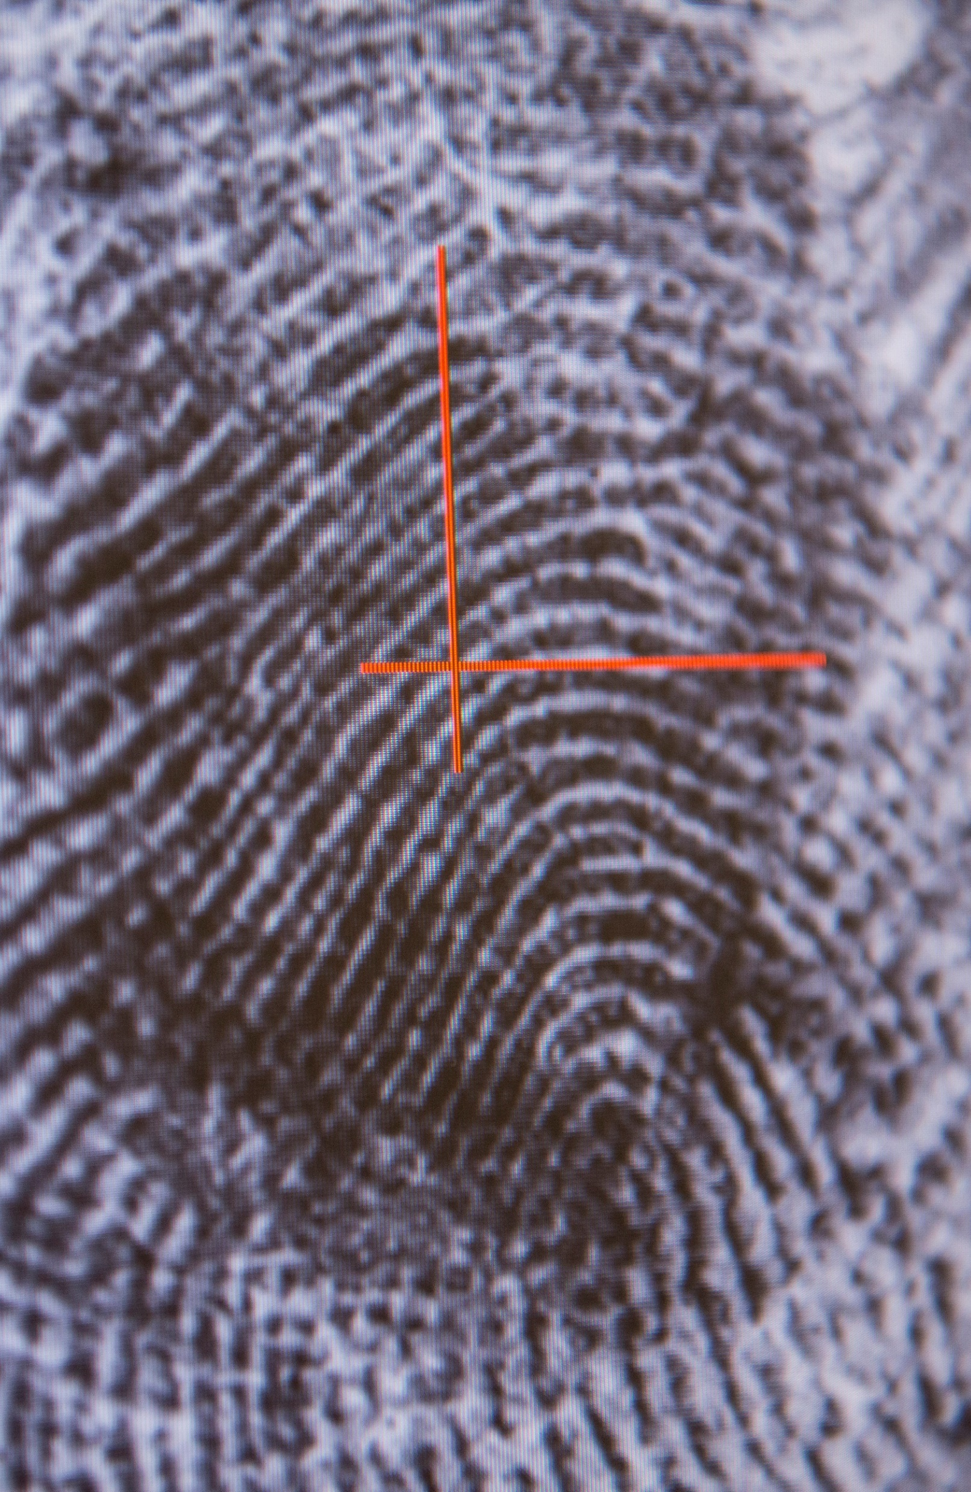
Feature vectors
A biometric feature vector is a representation of the unique characteristics or features from a given biometric sample.
Each element in a feature vector represents an aspect of the modality:
The texture from a fingerprint can be measured using the ridges and bifurcations that are unique to everyone.
Specific sections of the human iris can be isolated and compared using high resolution imagery.
In facial recognition, an algorithm might measure the location of different facial features. E.g., The distance between an individual's eyes or the distance between their nose and mouth.

Slide 13
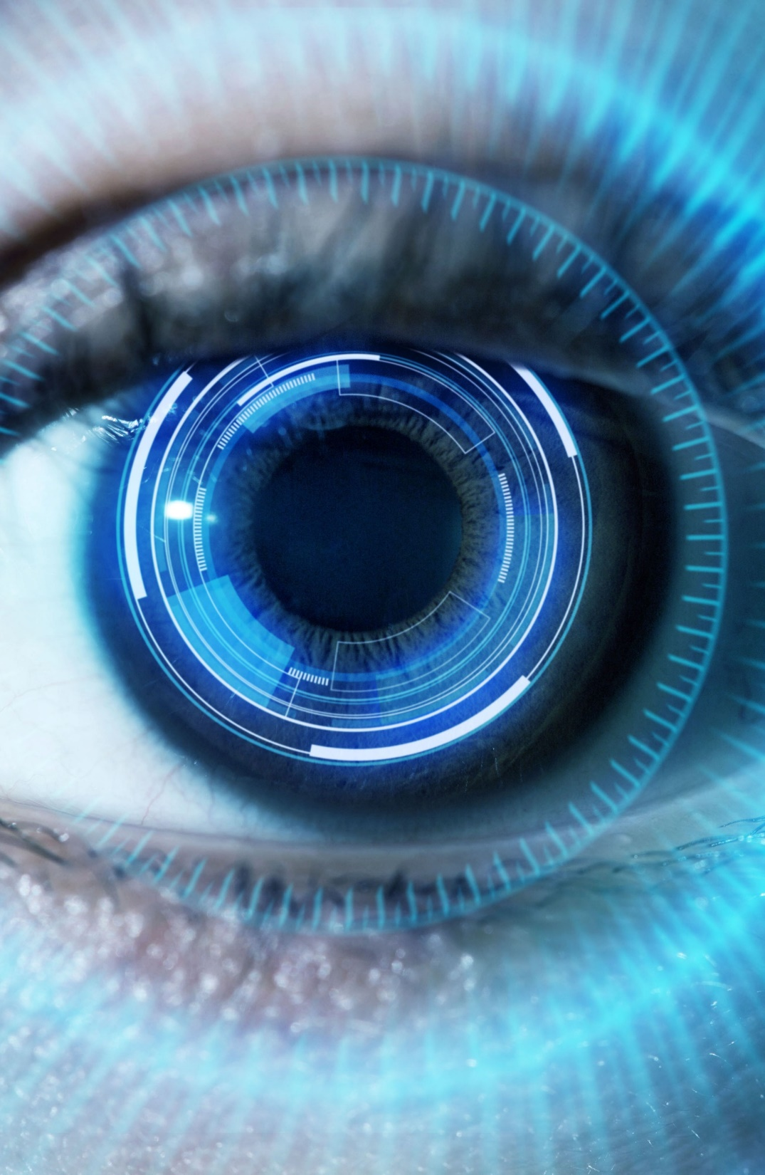
Pattern Classification
Feature 2
Impostor User 2
Impostor User 1
Impostor User 3
Authorised User
Feature 1

Slide 14
Activity: Biometric scores
Going back to the biometric technologies, enroll on each of the biometric systems and compare the scores that you get for each.
Fill out the worksheet as you try each of the different systems.

Slide 15
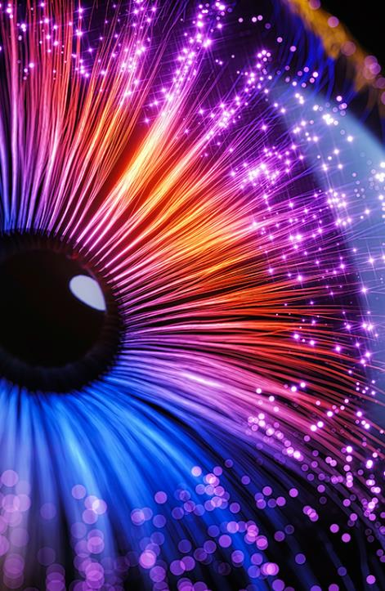
Biometric decision boundaries
The biometric scores are based upon the feature vectors of each of the modalities – iris, fingerprint, facial recognition etc.
Comparison of those features through decision boundaries are used to distinguish between different inputs and either classify input as a ‘match’ or ‘no-match.’
These decision boundaries exist in mobile phones usage of facial recognition or fingerprint scanners to unlock or in passports for international travel.
What score is likely to be sufficient for a match?

Slide 16
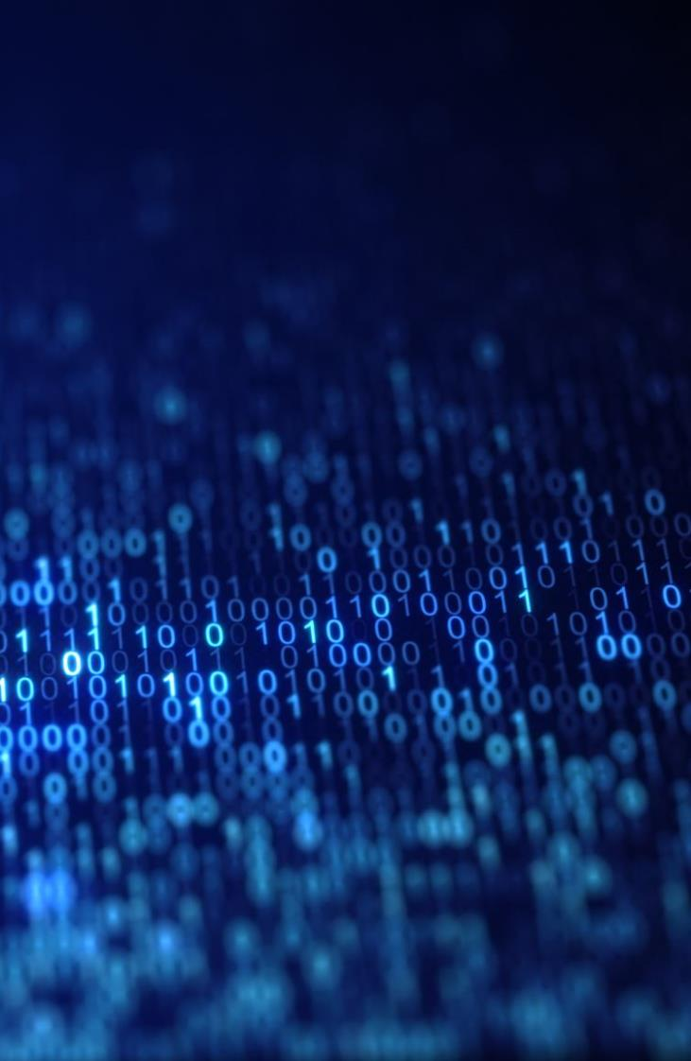
FAR / FRR relationship
100
False Acceptance Rate (FAR)
False Rejection Rate (FRR)
Rate (%)
Equal Error Rate
0
Slack
Tolerance / Threshold Setting
Tight
Increasing end-user rejection

Slide 17
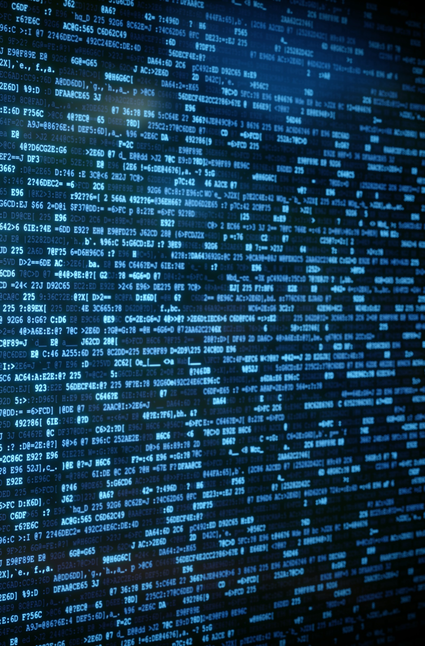
False rejection and false acceptance
False rejection - When a legitimate user who should be confirmed as a ‘match’ by the biometric system is incorrectly confirmed as ‘no-match’ and denied authentication.
False acceptance – When an illegitimate user or a threat actor is incorrectly confirmed as a ‘match’ by the system when a decision should have classified them as ‘no-match.’
E.g., When Apple first introduced facial recognition on their iPhones – a photograph of an individual could result in a ‘match.’

Slide 18
Activity: Varying inputs
Enroll on the biometric systems again, but this time try providing your biometric input in different ways.
With your fingers, try your fingertips or the sides of your fingers.
With your face, try from further away or with other people in view.

Slide 19
Discuss: Issues with variance
What did you notice, what issues came up when you tried to enroll this time?

Slide 20
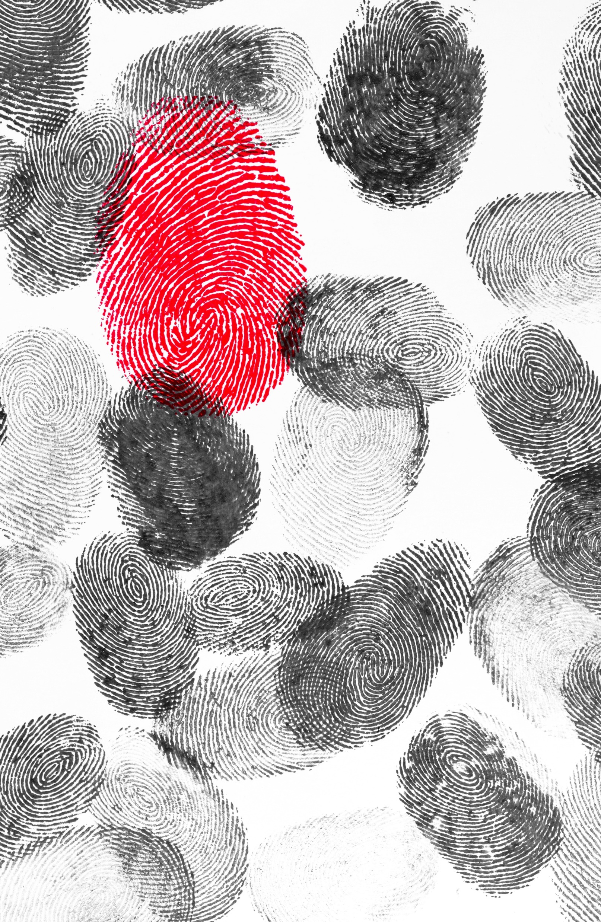
Liveliness tests
Liveliness tests help a biometric system determine whether an input sample is authentic – such as a real person rather than a photograph.
Facial Liveliness Detection:
Facial liveliness tests may involve analyzing blinking, eye movement, or subtle facial muscle movements.
Iris Liveliness Detection:
Iris liveliness tests can involve analyzing pupil dilation, eye movement, or the response to light stimuli.

Slide 21
Implementation effectiveness
Compared to passwords and tokens, biometrics offer a much more robust method for authentication.
However, the effectiveness of biometric systems depends on how comprehensive the system is and how well it is implemented.
A poorly implemented biometric system may be able to be bypassed with the aid of fingerprint moulds or high-resolution photographs.

Slide 22

Any Questions?
Thank You

